Slide 1

PROJECT UPDATE
Team Members:
(Quino) Joaquin Carretero Martinez
Himanish Prakash
(Doris) Mengyu Pu
(Sreeja) Sai Sreeja Macha

Slide 2





EXECUTIVE SUMMARY– SENTIMENT ANALYSIS
Q: How can a new call-to-action plan with Twitter posts improve Conference churning?
A: Boosts attendee retention by 10% and increases attendee engagement by 25%, potentially adding an extra $50K in revenue
From repeat and engaged participants.
VALIDATION: 5-fold cross-validation shows that the estimate is 85% accurate.
We are 95% confident that the actual increase in attendee retention falls within a range of ±2%, and the improvement in engagement
level ​falls within a range of ±5%.
KPIs:
Attendee Retention Rate
Attendee Engagement Level
Observations: 2,000 tweets analyzed
to date.
DATA:
Source: Twitter, LinkedIn
Targeted Tweets: Tweets using targeted hashtags like #INFORMS, #INFORMS2023, etc.
Variables: 10 (incl. Sentiment Score, Hashtag, Engagement Rate, Tweet Volume).
Timeframe: Nov 2023 – Mar 2024.
METHODOLOGY: Support Vector Machine (SVM) model for classifying tweets and performing sentiment analysis, followed by regression analysis to determine the impact on attendee retention and engagement rates.
ROADMAP:
Tweets Collection
Data Analysis
Feb 01, '24
Modeling
Advanced Analysis
Feb 12, '24
April 02, '24
Jan 15, '24
May 28, '24
Reporting
June 15, '24
Project Closure
Notes:
What value do we get from having real time attendee feedback?
By getting to the root of the issue within 3h, we can get better churning for other conferences.
What does this churning look like? Increase in 20% of attendees year to year due to better reviews
Does adding particular hashtag linked to conferences help in better conversion of participants?
How can these insights guide strategic improvements in conference planning and execution?
DATA:
Source: Twitter
Element: posts with "@INFORMS", "#INFORMS"
Period: from date to date
METHOD:
Used sentiment analysis to analyze existing twitter posts to get positive and negative comments.
Completed a business proposal on how to use #INFORMS more effectively to increase #INFORMS utilization
ROADMAP:

Slide 3
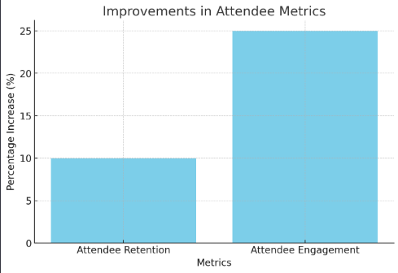
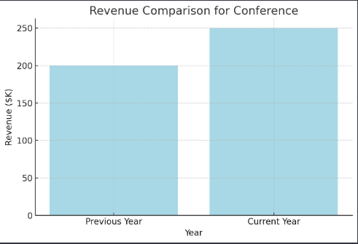
Mock-Up Results– SENTIMENT ANALYSIS
Increase in attention retention by 10% and attendee engagement by 25%
Increase in revenue by $50k

Slide 4
METHODOLOGY – PATH TO SUCCESS
1. Define Objectives:
Goal: Instantly track and act on feedback from social media for INFORMS conferences.
2. Set Up Monitoring:
Monitor social media for mentions using keywords like "#informs", "INFORMS", and other relevant terms.
3. Data Collection:
Automatically collect posts and comments mentioning these keywords in real time.
4. Quick Analysis:
Filter and categorize feedback (logistics, content, etc.).
Assess sentiment (positive, negative, neutral).
5. Immediate Action:
Identify and implement quick fixes during the conference based on feedback.
6. Performance Assessment:
Compare feedback volume and sentiment against previous events to gauge impact.
7. Reporting:
Summarize key feedback and actions taken for executive review.
Use insights for future event planning improvement.
8. Adjust and Refine:
Post-event, refine strategy for better feedback capture and action in future conferences

Slide 5
EXPLORATORY DATA ANALYSIS: KEY VAIRABLES
Continuous Variables Summary:
Variable | Definition | Number(Actively adding) | Calculation | Missing
replies | Reply number for each posts | 2000+ | NA | 0
retweets | Retweets number for each posts | 2000+ | NA | 0
likes | Likes number for each posts | 2000+ | NA | 0
Sentiment Score | Assess sentiment (positive, negative, neutral) | 2000+ | Based on Sentiment analysis | 0
Engagement Rate | Number of people actively engaging with social media content | 2000+ | SUM(like, retweet) | 0
Tweet Volume | Sum of posts and comments for a period | 2000+ | COUNT(tweet_id) GROUP BY(DAY) | 0
Categorical Variables Summary
Variable | Definition | Number | Missing
tweet_id | Unique ID for every post | 2000+ | 0
text | The content of each post | 2000+ | 0
username | Distinct username | 2000+ | 0
timestamp | Post Release Time | 2000+ | 0
Hashtag | Hashtag used in the post | 2000+ | 0

Slide 6
Method: Social Media Engagement Analysis
Model:
SocialM​ediaM​etric = f(Conference_Activities, #informs_Usage, Related_Keywords, Time, Other_Controls)
Objective:
Evaluate the impact and real time feedback of INFORMS conferences through real-time social media feedback using the hashtag #informs and related keywords.
Approach:
Data Aggregation: Collect social media mentions during the conference timeframe.
Metric Analysis: Track volume, sentiment, and engagement of #informs-related posts.
Comparative Metrics: Contrast social media activity before, during, and after the conference to assess impact.
Challenges:
Filtering out noise and irrelevant mentions.
Accurately interpreting sentiment of feedback.
Tools & Software: Apify LinkedIn, Twitter, Instagram APIs, Python, R, ChatGPT
Success Evaluation:
Increased engagement metrics (likes, shares, comments).
Timely incorporation of feedback into conference activities.

Slide 7

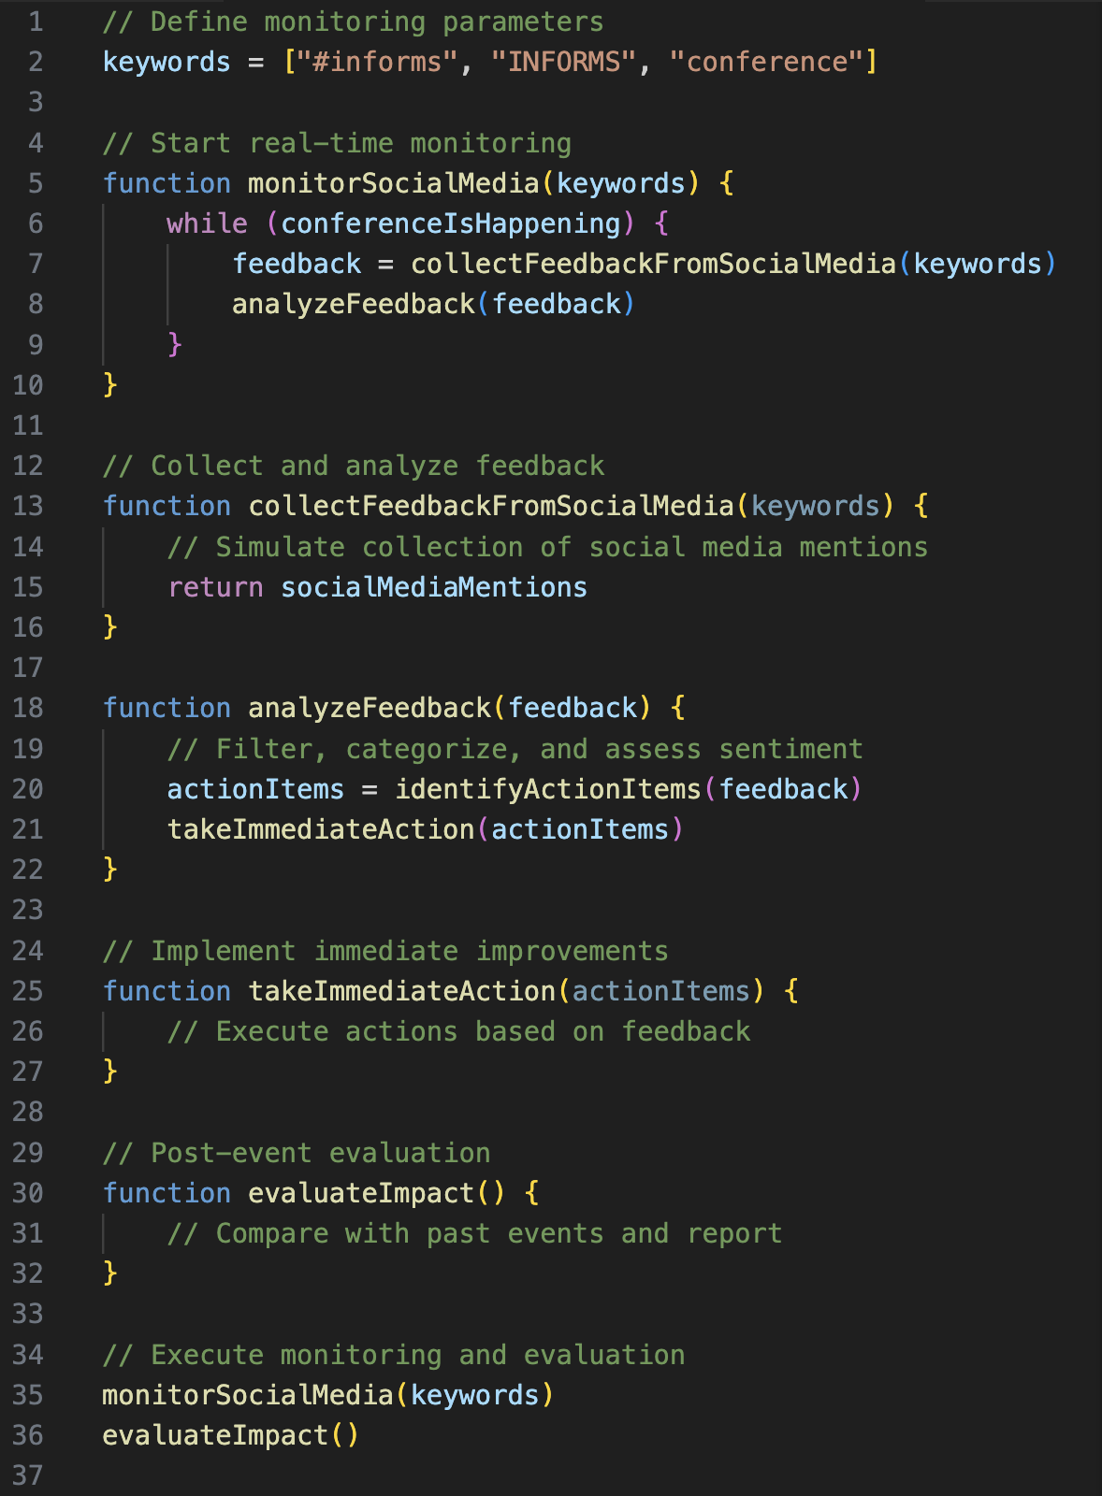




Pseudo-Code

